Slide 1

TCP: Overview
point-to-point:
  one sender, one receiver
reliable, in-order byte steam:
  no “message boundaries”
pipelined:
  TCP congestion and flow control set window size
send & receive buffers
full duplex data:
  bi-directional data flow in same connection
  MSS: maximum segment size
connection-oriented:
  handshaking (exchange of control msgs) init’s sender, receiver state before data exchange
flow controlled:
  sender will not overwhelm receiver

Slide 2
TCP segment structure
32 bits
URG: urgent data
(generally not used)
counting
by bytes
of data
(not segments!)
source port #
dest port #
sequence number
ACK: ACK #
valid
acknowledgement number
head
len
not
used
U
Receive window
A
PSH: push data now
(generally not used)
P
R
S
F
# bytes
rcvr willing
to accept
checksum
Urg data pnter
RST, SYN, FIN:
connection estab
(setup, teardown
commands)
Options (variable length)
application
data
(variable length)
Internet
checksum
(as in UDP)

Slide 3

TCP seq. #’s and ACKs
Seq. #’s:
  byte stream “number” of first byte in segment’s data
ACKs:
  seq # of next byte expected from other side
  cumulative ACK
Q: how receiver handles out-of-order segments
  A: TCP spec doesn’t say, - up to implementor
Host A
Host B
User
types
‘C’
Seq=42, ACK=79, data = ‘C’
host ACKs
receipt of
‘C’, echoes
back ‘C’
Seq=79, ACK=43, data = ‘C’
host ACKs
receipt
of echoed
‘C’
Seq=43, ACK=80
time
simple telnet scenario

Slide 4
TCP Round Trip Time and Timeout
Q: how to set TCP timeout value?
longer than RTT
  but RTT varies
too short: premature timeout
  unnecessary retransmissions
too long: slow reaction to segment loss
Q: how to estimate RTT?
SampleRTT: measured time from segment transmission until ACK receipt
  ignore retransmissions
SampleRTT will vary, want estimated RTT “smoother”
  average several recent measurements, not just current SampleRTT

Slide 5

Example RTT estimation:

Slide 6
TCP Round Trip Time and Timeout
EstimatedRTT = (1- α)*EstimatedRTT + α*SampleRTT
Exponential weighted moving average
influence of past sample decreases exponentially fast
typical value: α = 0.125

Slide 7
TCP Round Trip Time and Timeout
Setting the timeout
EstimtedRTT plus “safety margin”
  large variation in EstimatedRTT -> larger safety margin
first estimate of how much SampleRTT deviates from EstimatedRTT:
DevRTT = (1-β)*DevRTT +
β*|SampleRTT-EstimatedRTT|
(typically, β = 0.25)
Then set timeout interval:
TimeoutInterval = EstimatedRTT + 4*DevRTT

Slide 8
TCP reliable data transfer
TCP creates rdt service on top of IP’s unreliable service
Pipelined segments
Cumulative acks
TCP uses single retransmission timer
Retransmissions are triggered by:
  timeout events
  duplicate acks
Initially consider simplified TCP sender:
  ignore duplicate acks
  ignore flow control, congestion control

Slide 9
TCP sender events:
data rcvd from app:
Create segment with seq #
seq # is byte-stream number of first data byte in segment
start timer if not already running (think of timer as for oldest unacked segment)
expiration interval: TimeOutInterval
timeout:
retransmit segment that caused timeout
restart timer
Ack rcvd:
If acknowledges previously unacked segments
  update what is known to be acked
  start timer if there are outstanding segments

Slide 10
TCP sender
(simplified)
NextSeqNum = InitialSeqNum
SendBase = InitialSeqNum
loop (forever) {
switch(event)
event: data received from application above
create TCP segment with sequence number NextSeqNum
if (timer currently not running)
start timer
pass segment to IP
NextSeqNum = NextSeqNum + length(data)
event: timer timeout
retransmit not-yet-acknowledged segment with
smallest sequence number
start timer
event: ACK received, with ACK field value of y
if (y > SendBase) {
SendBase = y
if (there are currently not-yet-acknowledged segments)
start timer
}
} /* end of loop forever */
Comment:
SendBase-1: last
cumulatively
ack’ed byte
Example:
SendBase-1 = 71;
y= 73, so the rcvr
wants 73+ ;
y > SendBase, so
that new data is
acked

Slide 11
TCP: retransmission scenarios
Host A
Host B
Host A
Host B
Seq=92, 8 bytes data
Seq=92, 8 bytes data
Seq=100, 20 bytes data
timeout
ACK=100
Seq=92 timeout
X
ACK=100
loss
ACK=120
Seq=92, 8 bytes data
Sendbase
= 100
Seq=92, 8 bytes data
SendBase
= 120
Seq=92 timeout
ACK=120
ACK=100
SendBase
= 100
SendBase
= 120
premature timeout
time
time
lost ACK scenario

Slide 12
TCP retransmission scenarios (more)
Host A
Host B
Seq=92, 8 bytes data
ACK=100
timeout
Seq=100, 20 bytes data
X
loss
SendBase
= 120
ACK=120
time
Cumulative ACK scenario

Slide 13
TCP ACK generation
Event at Receiver
Arrival of in-order segment with
expected seq #. All data up to
expected seq # already ACKed
Arrival of in-order segment with
expected seq #. One other
segment has ACK pending
Arrival of out-of-order segment
higher-than-expect seq. # .
Gap detected
Arrival of segment that
partially or completely fills gap
TCP Receiver action
Delayed ACK. Wait up to 500ms
for next segment. If no next segment,
send ACK
Immediately send single cumulative
ACK, ACKing both in-order segments
Immediately send duplicate ACK,
indicating seq. # of next expected byte
Immediate send ACK, provided that
segment startsat lower end of gap

Slide 14
Fast Retransmit
Time-out period often relatively long:
  long delay before resending lost packet
Detect lost segments via duplicate ACKs.
  Sender often sends many segments back-to-back
  If segment is lost, there will likely be many duplicate ACKs.
If sender receives 3 ACKs for the same data, it supposes that segment after ACKed data was lost:
  fast retransmit: resend segment before timer expires

Slide 15

TCP Flow Control
flow control
sender won’t overflow
receiver’s buffer by
transmitting too much,
too fast
receive side of TCP connection has a receive buffer:
speed-matching service: matching the send rate to the receiving app’s drain rate
app process may be slow at reading from buffer

Slide 16
TCP Flow control: how it works
Rcvr advertises spare room by including value of RcvWindow in segments
Sender limits unACKed data to RcvWindow
  guarantees receive buffer doesn’t overflow
(Suppose TCP receiver discards out-of-order segments)
spare room in buffer
= RcvWindow
= RcvBuffer-[LastByteRcvd - LastByteRead]

Slide 17
TCP Connection Management
Recall: TCP sender, receiver establish “connection” before exchanging data segments
initialize TCP variables:
  seq. #s
  buffers, flow control info (e.g. RcvWindow)
client: connection initiator
Socket opens
server: contacted by client
Socket welcomed
Three way handshake:
Step 1: client host sends TCP SYN segment to server
  specifies initial seq #
  no data
Step 2: server host receives SYN, replies with SYNACK segment
  server allocates buffers
  specifies server initial seq. #
Step 3: client receives SYNACK, replies with ACK segment, which may contain data

Slide 18
TCP Connection Management (cont.)
Closing a connection:
client closes socket
Step 1: client end system sends TCP FIN control segment to server
Step 2: server receives FIN, replies with ACK. Closes connection, sends FIN.
client
server
close
FIN
ACK
close
FIN
ACK
timed wait
closed

Slide 19
TCP Connection Management (cont.)
Step 3: client receives FIN, replies with ACK.
  Enters “timed wait” - will respond with ACK to received FINs
Step 4: server, receives ACK. Connection closed.
client
server
closing
FIN
ACK
closing
FIN
ACK
timed wait
closed
closed

Slide 20


TCP Connection Management (cont)
TCP server
lifecycle
TCP client
lifecycle

Slide 21
Principles of Congestion Control
Congestion:
informally: “too many sources sending too much data too fast for network to handle”
different from flow control!
manifestations:
  lost packets (buffer overflow at routers)
  long delays (queueing in router buffers)
a problem – many researchers are working on

Slide 22

Causes/costs of congestion: scenario 1
two senders, two receivers
one router, infinite buffers
no retransmission
Host A
λ_{in} : original data
λ_{out}
Host B
unlimited shared output link buffers
large delays when congested
maximum achievable throughput

Slide 23
Causes/costs of congestion: scenario 2
one router, finite buffers
sender retransmission of lost packet
Host A
λ_{in} : original data
λ_{out}
λ'_{in} : original data, plus retransmitted data
Host B
finite shared output link buffers

Slide 24
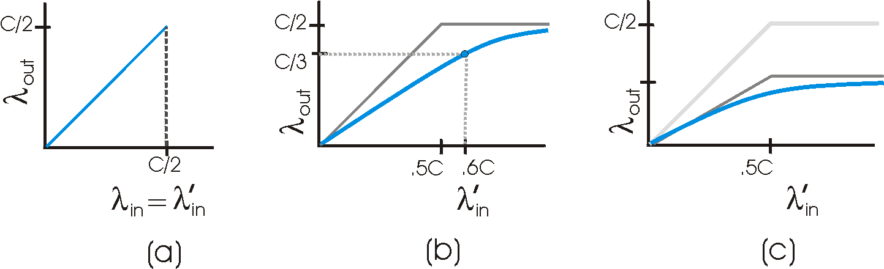
Causes/costs of congestion: scenario 2
λ
=
λ
always: (goodput)
“perfect” retransmission only when loss:
retransmission of delayed (not lost) packet makes larger (than perfect case) for same
in
out
λ
>
λ
in
out
λ
λ
in
out
“costs” of congestion:
more work (retrans) for given “goodput”
unneeded retransmissions: link carries multiple copies of pkt

Slide 25
Causes/costs of congestion: scenario 3
λ
four senders
multihop paths
timeout/retransmit
Q: what happens as and increase ?
λ
in
in
Host A
λ_{in} : original data
λ_{out}
λ'_{in} : original data, plus retransmitted data
finite shared output link buffers
Host B

Slide 26

Causes/costs of congestion: scenario 3
Host A
λ_{out}
Host B
Another “cost” of congestion:
when packet dropped, any “upstream transmission capacity used for that packet was wasted!

Slide 27
Approaches towards congestion control
Two broad approaches towards congestion control:
End-end congestion control:
no explicit feedback from network
congestion inferred from end-system observed loss, delay
approach taken by TCP
Network-assisted congestion control:
routers provide feedback to end systems
  single bit indicating congestion (special bits)
  explicit rate sender should send at

Slide 28
TCP Congestion Control
end-end control (no network assistance)
sender limits transmission:
LastByteSent-LastByteAcked
≤ min{CongWin,RcvWindow}
Roughly,
CongWin is dynamic, function of perceived network congestion
How does sender perceive congestion?
loss event = timeout or 3 duplicate acks
TCP sender reduces rate (CongWin) after loss event
three mechanisms:
  AIMD
  slow start
  conservative after timeout events
CongWin
rate =
Bytes/sec
RTT

Slide 29

TCP AIMD
multiplicative decrease: cut CongWin in half after loss event
additive increase: increase CongWin by 1 MSS every RTT in the absence of loss events: probing
Long-lived TCP connection

Slide 30
TCP Slow Start
When connection begins, increase rate exponentially fast until first loss event
When connection begins, CongWin = 1 MSS
  Example: MSS = 500 bytes & RTT = 200 msec
  initial rate = 20 kbps
available bandwidth may be >> MSS/RTT
  desirable to quickly ramp up to respectable rate

Slide 31
TCP Slow Start (more)
When connection begins, increase rate exponentially until first loss event:
  double CongWin every RTT
  done by incrementing CongWin for every ACK received
Summary: initial rate is slow but ramps up exponentially fast
Host A
Host B
one segment
RTT
two segments
four segments
time

Slide 32
Refinement
Philosophy:
3 dup ACKs indicates
network capable of
delivering some segments
timeout before 3 dup
ACKs is “more alarming”
After 3 dup ACKs:
  CongWin is cut in half
  window then grows linearly
But after timeout event:
  CongWin instead set to 1 MSS;
  window then grows exponentially
  to a threshold, then grows linearly

Slide 33
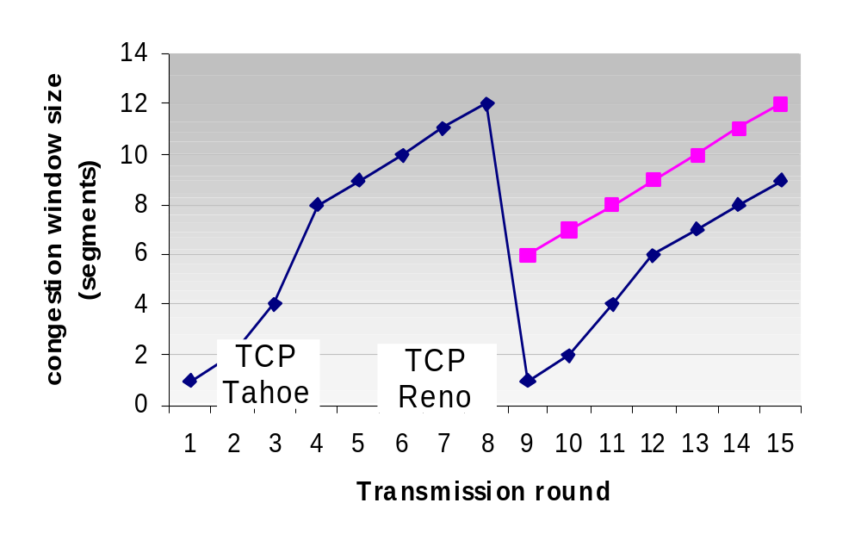
Refinement (more)
Q: When should the exponential increase switch to linear?
A: When CongWin gets to 1/2 of its value before timeout.
Implementation:
Variable Threshold
At loss event, Threshold is set to 1/2 of CongWin just before loss event

Slide 34
Summary: TCP Congestion Control
When CongWin is below Threshold, sender in slow-start phase, window grows exponentially.
When CongWin is above Threshold, sender is in congestion-avoidance phase, window grows linearly.
When a triple duplicate ACK occurs, Threshold set to CongWin/2 and CongWin set to Threshold.
When timeout occurs, Threshold set to CongWin/2 and CongWin is set to 1 MSS.

Slide 35
TCP Fairness
Fairness goal: if K TCP sessions share same bottleneck link of bandwidth R, each should have average rate of R/K
TCP connection 1
TCP
connection 2
bottleneck
router
capacity R

Slide 36
Why is TCP fair?
Two competing sessions:
Additive increase gives slope of 1, as throughout increases
multiplicative decrease decreases throughput
R
equal bandwidth share
loss: decrease window by factor of 2
congestion avoidance: additive increase
Connection 2 throughput
loss: decrease window by factor of 2
congestion avoidance: additive increase
Connection 1 throughput
R

Slide 37
Fairness (more)
Fairness and UDP
Multimedia apps often do not use TCP
  do not want rate throttled by congestion control
Instead use UDP:
  pump audio/video at constant rate, tolerate packet loss
Research area: TCP friendly
Fairness and parallel TCP connections
nothing prevents app from opening parallel cnctions between 2 hosts.
Web browsers do this
Example: link of rate R supporting 9 cnctions;
  new app asks for 1 TCP, gets rate R/10
  new app asks for 11 TCPs, gets R/2 !

Slide 38
Delay modeling
Notation, assumptions:
Assume one link between client and server of rate R
S: MSS (bits)
O: object size (bits)
no retransmissions (no loss, no corruption)
Window size:
First assume: fixed congestion window, W segments
Then dynamic window, modeling slow start
Q: How long does it take to receive an object from a Web server after sending a request?
Ignoring congestion, delay is influenced by:
TCP connection establishment
data transmission delay
slow start

Slide 39
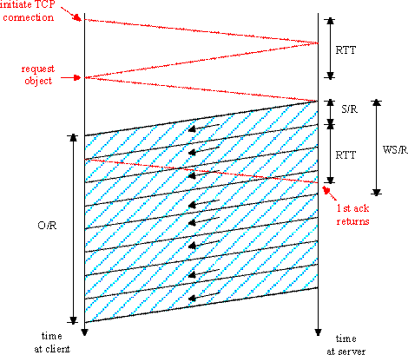
Fixed congestion window (1)
First case:
WS/R > RTT + S/R: ACK for first segment in window returns before window’s worth of data sent
delay = 2RTT + O/R

Slide 40
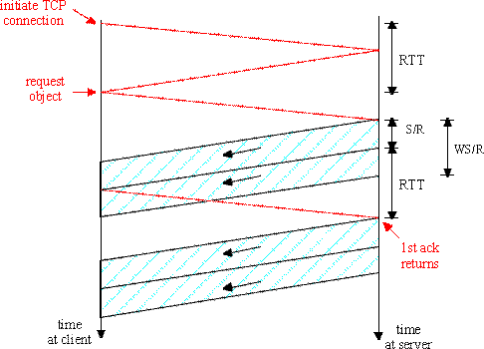
Fixed congestion window (2)
Second case:
WS/R < RTT + S/R: wait for ACK after sending window’s worth of data sent
delay = 2RTT + O/R
+ (K-1)[S/R + RTT - WS/R]

Slide 41
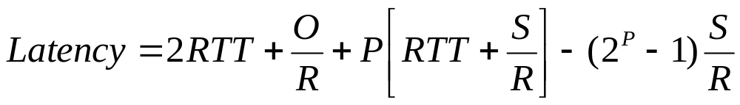

TCP Delay Modeling: Slow Start (1)
Now suppose window grows according to slow start
Will show that the delay for one object is:
where P is the number of times TCP idles at server:
- where Q is the number of times the server idles
if the object were of infinite size.
- and K is the number of windows that cover the object.

Slide 42
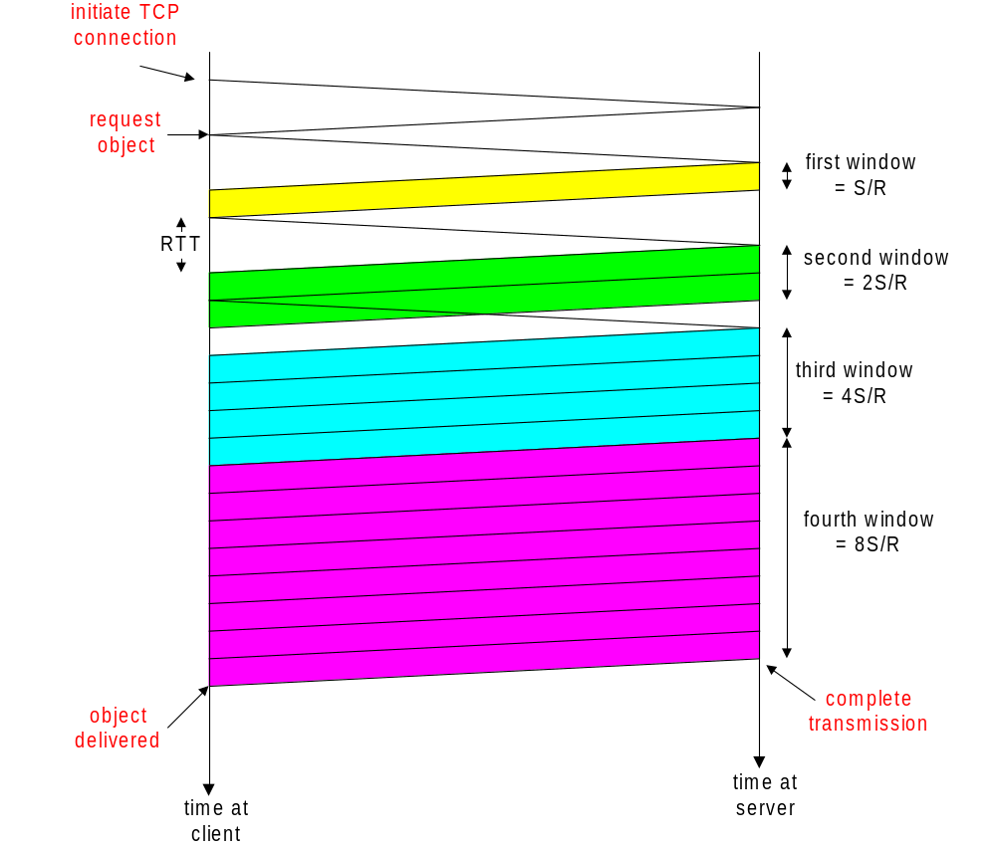
TCP Delay Modeling: Slow Start (2)
Delay components:
2 RTT for connection estab and request
O/R to transmit object
time server idles due to slow start
Server idles:
P = min{K-1,Q} times
Example:
O/S = 15 segments
K = 4 windows
Q = 2
P = min{K-1,Q} = 2
Server idles P=2 times

Slide 43
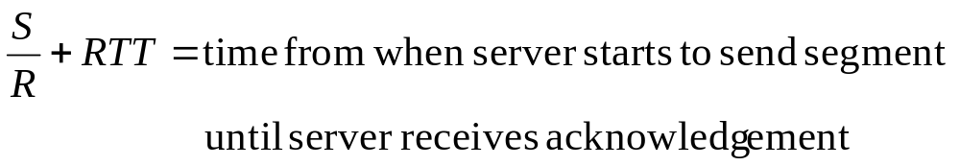
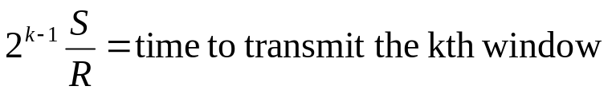
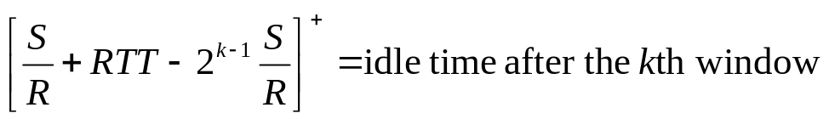
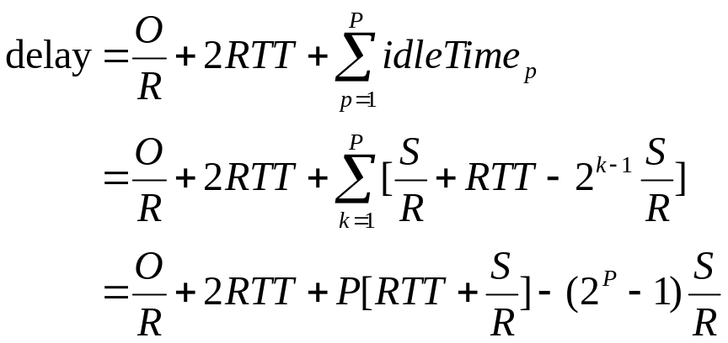
TCP Delay Modeling (3)

Slide 44
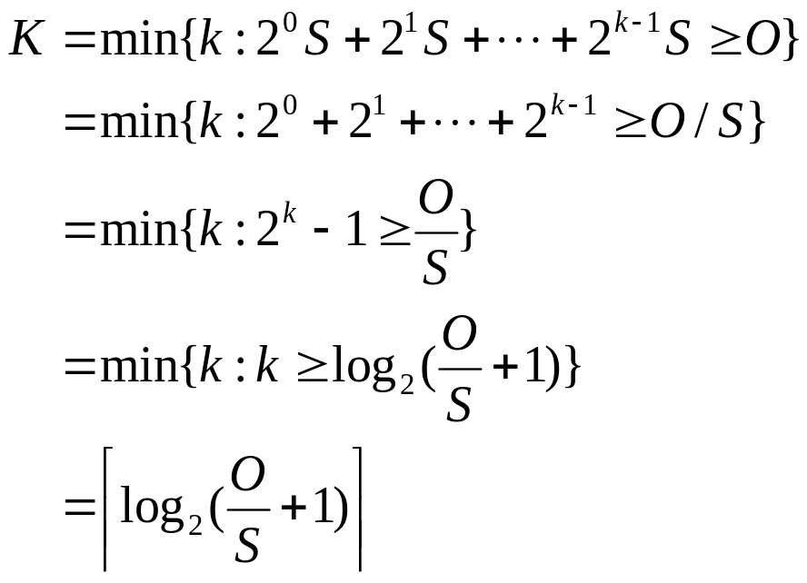
TCP Delay Modeling (4)
Recall K = number of windows that cover object
How do we calculate K ?
How do we calculate Q ?

